Slide 1
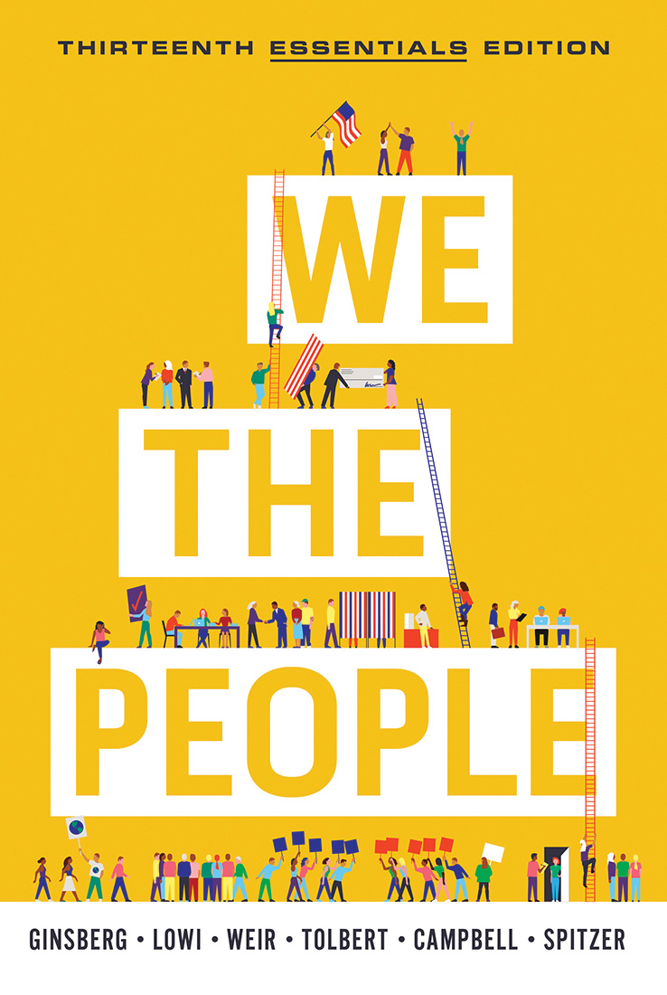
CHAPTER 13
The Federal Courts

Slide 2
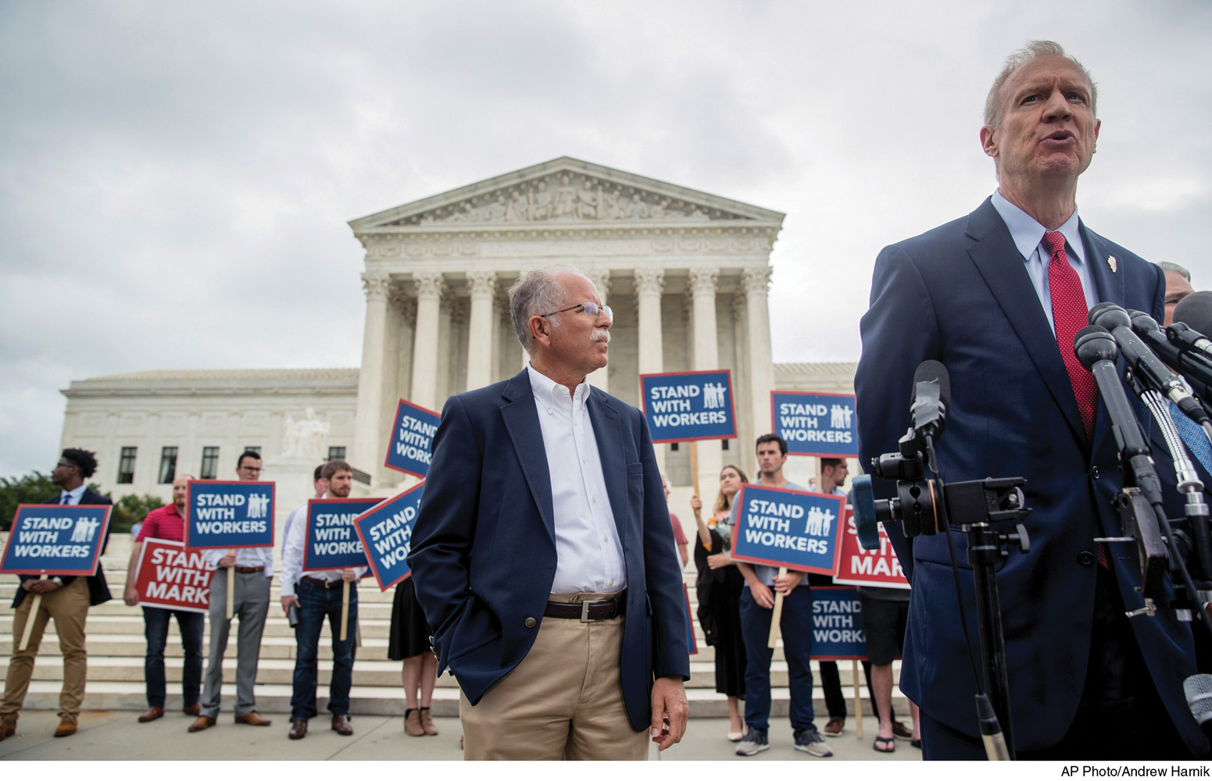
The Federal Courts
Notes:
Although the Supreme Court is often viewed as the least political of the three branches, its rulings touch on major political issues that affect Americans in many ways. Here, Mark Janus (left) celebrates with supporters after winning his Supreme Court case, which could have a profound effect on how unions operate.
[AP Photo/Andrew Harnik]

Slide 3
The Legal System: Criminal Law
Criminal law is the branch of law that regulates the conduct of individuals, defines crimes, and specifies punishments for criminal acts.
Government is always the plaintiff, or the party that brings charges to court.
It involves matters ranging from traffic offenses to murder.
Defendants who are found guilty of charges brought against them may be fined or sent to jail.

Slide 4
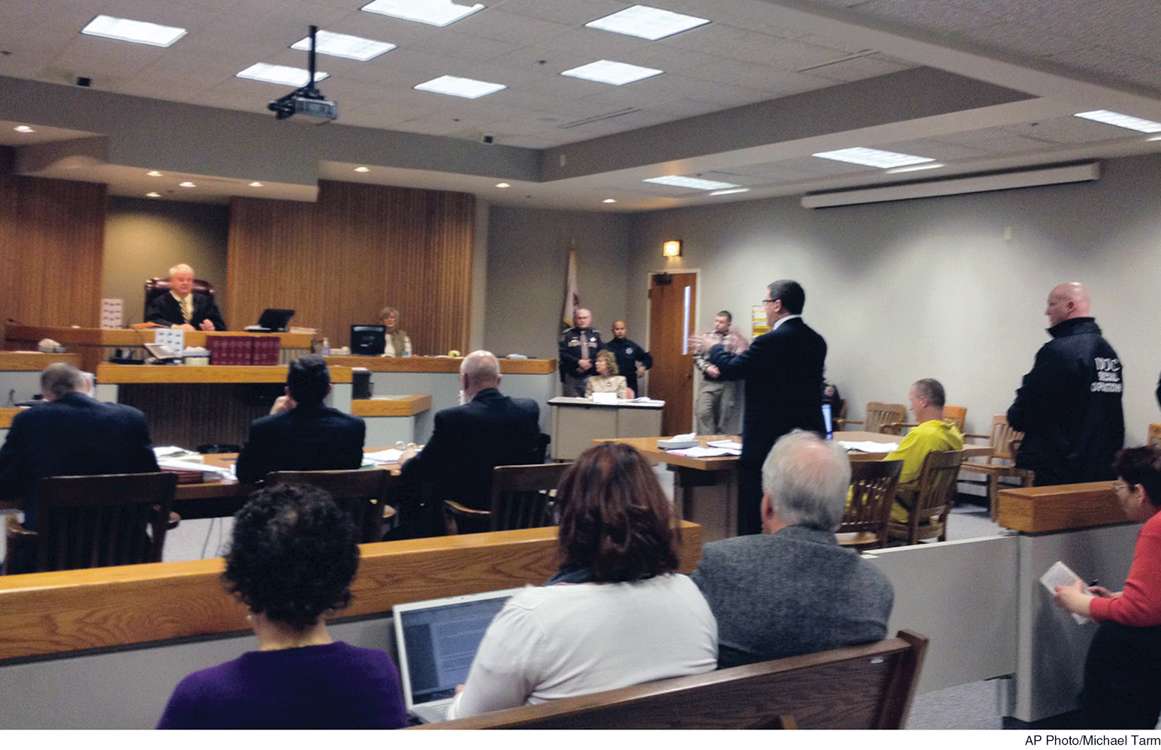
Criminal Cases
Notes:
In criminal cases, the government charges an individual with violating a statute protecting health, safety, morals, or welfare. Most such cases arise in state and municipal courts. Here, an Illinois county court hears testimony in a murder case.
[AP Photo/Michael Tarm]

Slide 5
The Legal System: Civil Law
Civil law is the branch of law that deals with disputes that do not involve criminal penalties.
These disputes may be among individuals, groups, corporations, and other private entities, or between such litigants and the government.
Losers in civil cases cannot be fined or sent to jail, but they may be required to pay monetary damages.
Contracts, torts, and administrative law are important in civil law.

Slide 6
The Legal System: Precedent
In deciding cases, courts apply statutes (laws) and legal precedents.
Precedent: a prior case whose principles are used by judges as the basis for their decision in present case
Precedent is applied under the doctrine of stare decisis.
This translates literally from Latin as “let the decision stand.”

Slide 7
Types of Courts
Courts have been established by federal government and state governments. More than 97 percent of all cases go to state court.
If a state case is brought to trial, it is heard in a state trial court: the first court to hear a case.
If there is a guilty verdict, the defendant may appeal to a higher court, usually the state court of appeals.
From there, appeals can go to the state supreme court: the highest court in the state. Supreme courts primarily serve an appellate function.
The government cannot appeal a “not guilty” verdict.

Slide 8
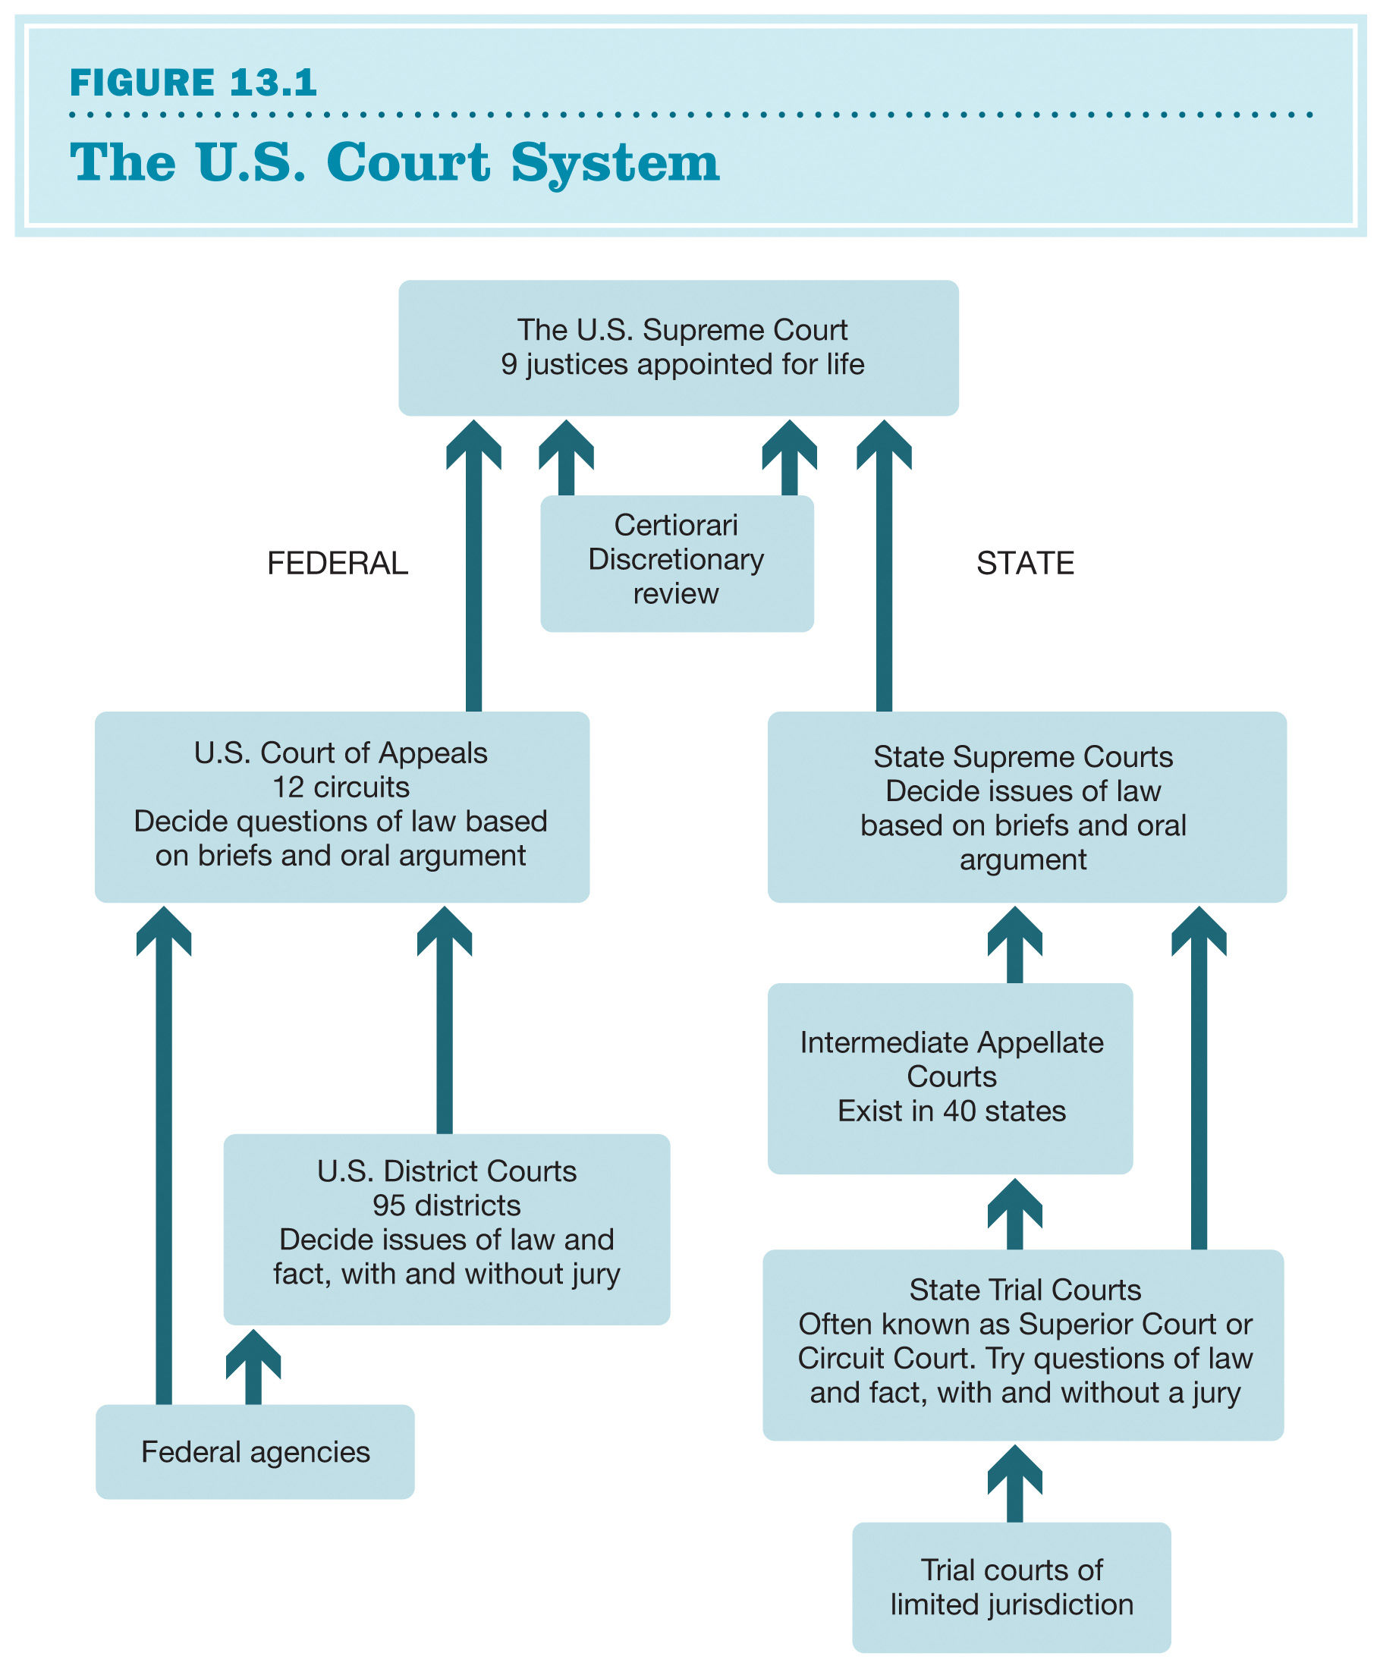
The U.S. Court System
Notes:
FIGURE 13.1 The U.S. Court System
The state and federal court systems parallel each other until they reach the U.S. Supreme Court. The Supreme Court hears appeals from both systems.

Slide 9
Types of Courts: Appellate Court
The party filing an appeal is known as an appellant. In order to appeal, the appellant must show that the trial court made a legal error in its decision.
When a case is appealed to a higher court:
Appeals courts do not hear witnesses.
New facts may not be introduced.
Notes:
Students may not be too familiar with appellate courts other than the Supreme Court.
At times, an appellate court will remand a case back to a trial court for that court to grapple with the law once the appellate court has determined the proper interpretation of the law for the case.
This is directly related to the difference between original jurisdiction and appellate jurisdiction.

Slide 10
The Plea Bargain
In both criminal and civil matters, most cases are settled before trial through negotiated agreements between the parties involved.
Plea bargain: a negotiated agreement in a criminal case in which a defendant agrees to plead guilty in return for the state’s agreement to reduce the severity of the criminal charge or prison sentence the defendant is facing

Slide 11
Types of Courts: Jurisdiction
Cases involving federal laws, treaties with other nations, or the Constitution go to federal court. These areas are the official jurisdiction—or sphere of power and authority—of the federal courts.
Federal courts will also hear cases in which:
the U.S. government is a party in the case
a civil suit involves citizens of more than one state and more than $75,000 is at stake
However, this depends on the preference of the plaintiff, who can opt to pursue the case in state courts instead.
Notes:
The matters and parties involved determine jurisdiction.
Federal courts engage, hear, and preside over only a limited subset of cases.
Appeals to federal courts arising from state cases involve arguments that a state is not applying its laws in conformity with the U.S. Constitution. This might involve requesting a writ of habeas corpus.

Slide 12
Types of Courts: Jurisdiction—The Supreme Court
Original jurisdiction is the authority to consider a case initially.
Article III of the Constitution gives the Supreme Court original jurisdiction in limited variety of cases, including those:
between the United States and one of the 50 states
between two or more states
involving foreign ambassadors or other ministers
brought by one state against citizens of another state or against a foreign nation

Slide 13
Types of Courts: Appellate Jurisdiction
State court decisions can be appealed to a federal court by raising a federal issue.
The defendant has options that might include:
claiming denial of due process of law: the right of every individual against arbitrary action by national or state governments
requesting a writ of habeas corpus: a court order that the individual in custody be brought into court and shown the cause for detention
The court will then evaluate whether the cause is sufficient and may order the release of a prisoner if it is found not to be.
The U.S. Supreme Court is not obligated to hear these appeals.

Slide 14
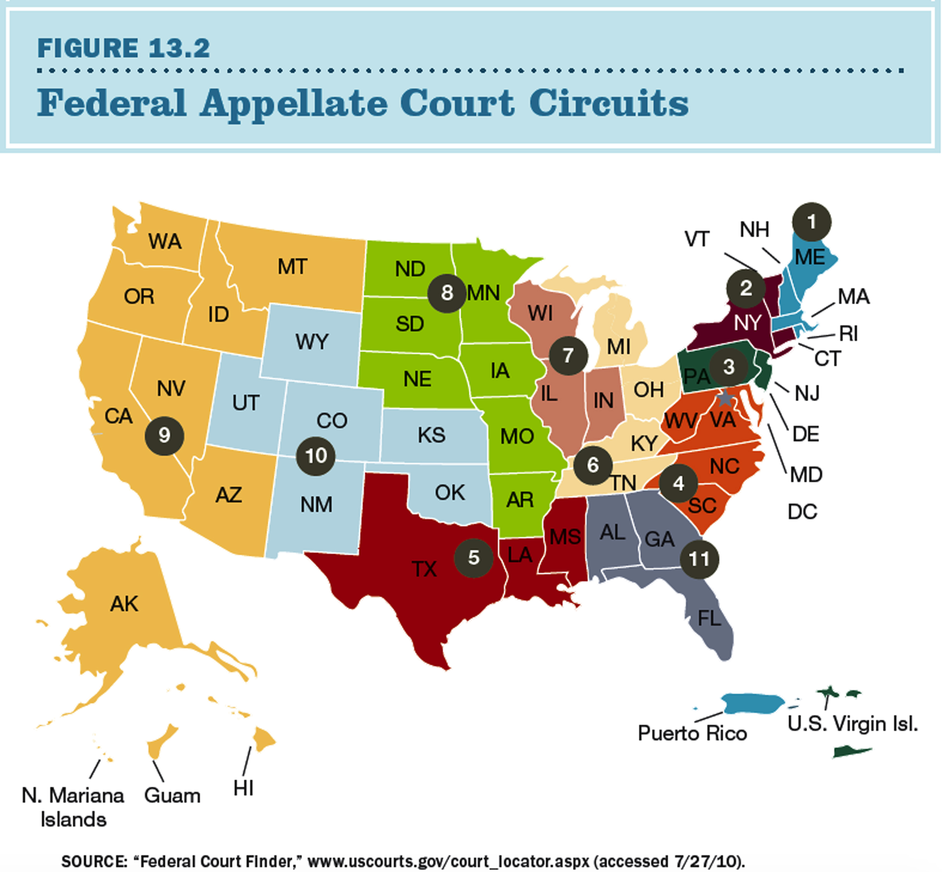
The Federal Appellate Courts: Circuits
Notes:
FIGURE 13.2 Federal Appellate Court Circuits
Federal district courts are organized into 12 regional circuits—the 11 shown here, plus the District of Columbia, which has its own circuit. Each circuit court hears appeals from lower federal courts within the circuit. A 13th federal circuit court, the U.S. Court of Appeals for the Federal Circuit, hears appeals from a number of specialized courts, such as the U.S. Court of Federal Claims.
SOURCE: “Federal Court Finder,” www.uscourts.gov/court_locator.aspx (accessed 7/27/10).

Slide 15
The Federal Courts: Trial Courts
Most cases of original federal jurisdiction are handled by federal district courts.
Congress has authorized the appointment of 678 federal district judges across 94 federal district courts.
The busiest of these courts may have as many as 28 judges.
Only one judge is assigned to each case, with an exception for cases where a statute calls for a three-judge panel.

Slide 16
The Federal Courts: Appellate Courts
Roughly 20 percent of all lower-court cases are reviewed by federal appeals courts.
There are 11 regional circuit courts, plus the D.C. circuit and the U.S. Court of Appeals for the Federal Circuit, including 179 court-of-appeals judges.
Unless reviewed by the U.S. Supreme Court, all decisions from an appeals court are final.
Built-in safeguards include the provision of more than one judge for every appeals case and the assignment of a Supreme Court justice to every circuit.
Each circuit has 6 to 28 permanent justices, and normally three of these judges hear each case.

Slide 17
The Federal Courts: Supreme Court
The U.S. Supreme Court is the highest court in the nation.
Article III of the Constitution vests “the judicial power of the United States” in the Supreme Court.
It consists of nine justices.
The chief justice presides over the Court’s public sessions.
The Constitution does not specify the number of justices; Congress has the authority to change the Court’s size.
It has the right to make the final interpretation over the U.S. Constitution and statutory law, be it state or federal.
Notes:
The system is steeped in seniority.
When the nine justices meet in conference, the most junior justice must answer the door when papers or food are delivered. As you might imagine, Justice Breyer drew the short end of the stick on this one, having served as “junior justice” from 1994 until 2006!

Slide 18
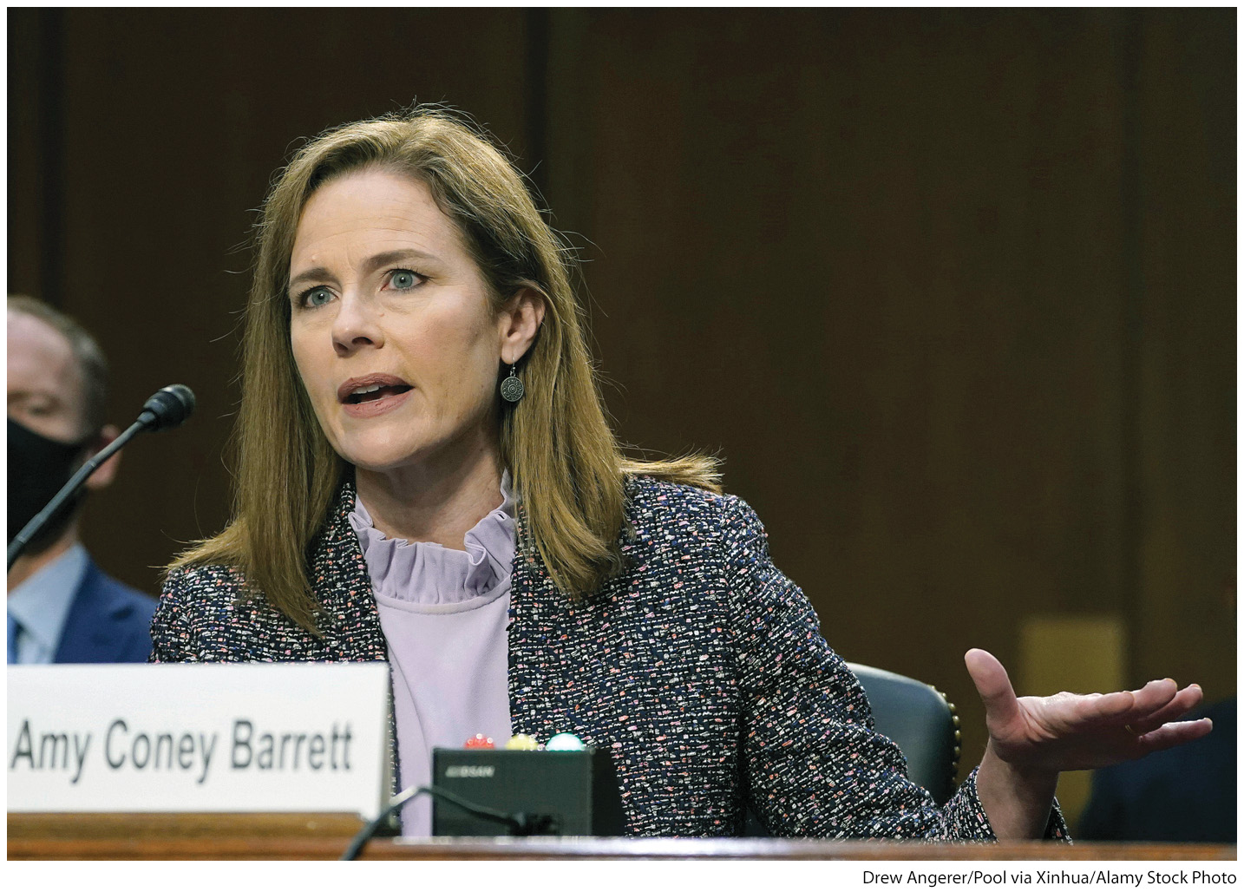
Supreme Court Nominations: Amy Coney Barrett
Notes:
Senate Republicans’ strategy to not take up Obama’s nomination of Merrick Garland, and to eliminate filibusters on Supreme Court nominations, paid off when President Trump nominated Neil Gorsuch in 2017 and Brett M. Kavanaugh in 2018. When Justice Ruth Bader Ginsburg passed away in 2020, the Trump administration nominated another justice to the bench, Judge Amy Coney Barrett, pictured here.
[Drew Angerer/Pool via Xinhua/Alamy Stock Photo]

Slide 19
The Federal Courts: Appointments
Federal judges are nominated by the president and confirmed by U.S. Senate.
They are generally selected from state court judges or state or local prosecutors.
In general, presidents try to appoint judges whose partisan and ideological views are similar to their own.
The nominee is considered by the Senate Judiciary Committee and then confirmed by the full Senate.

Slide 20
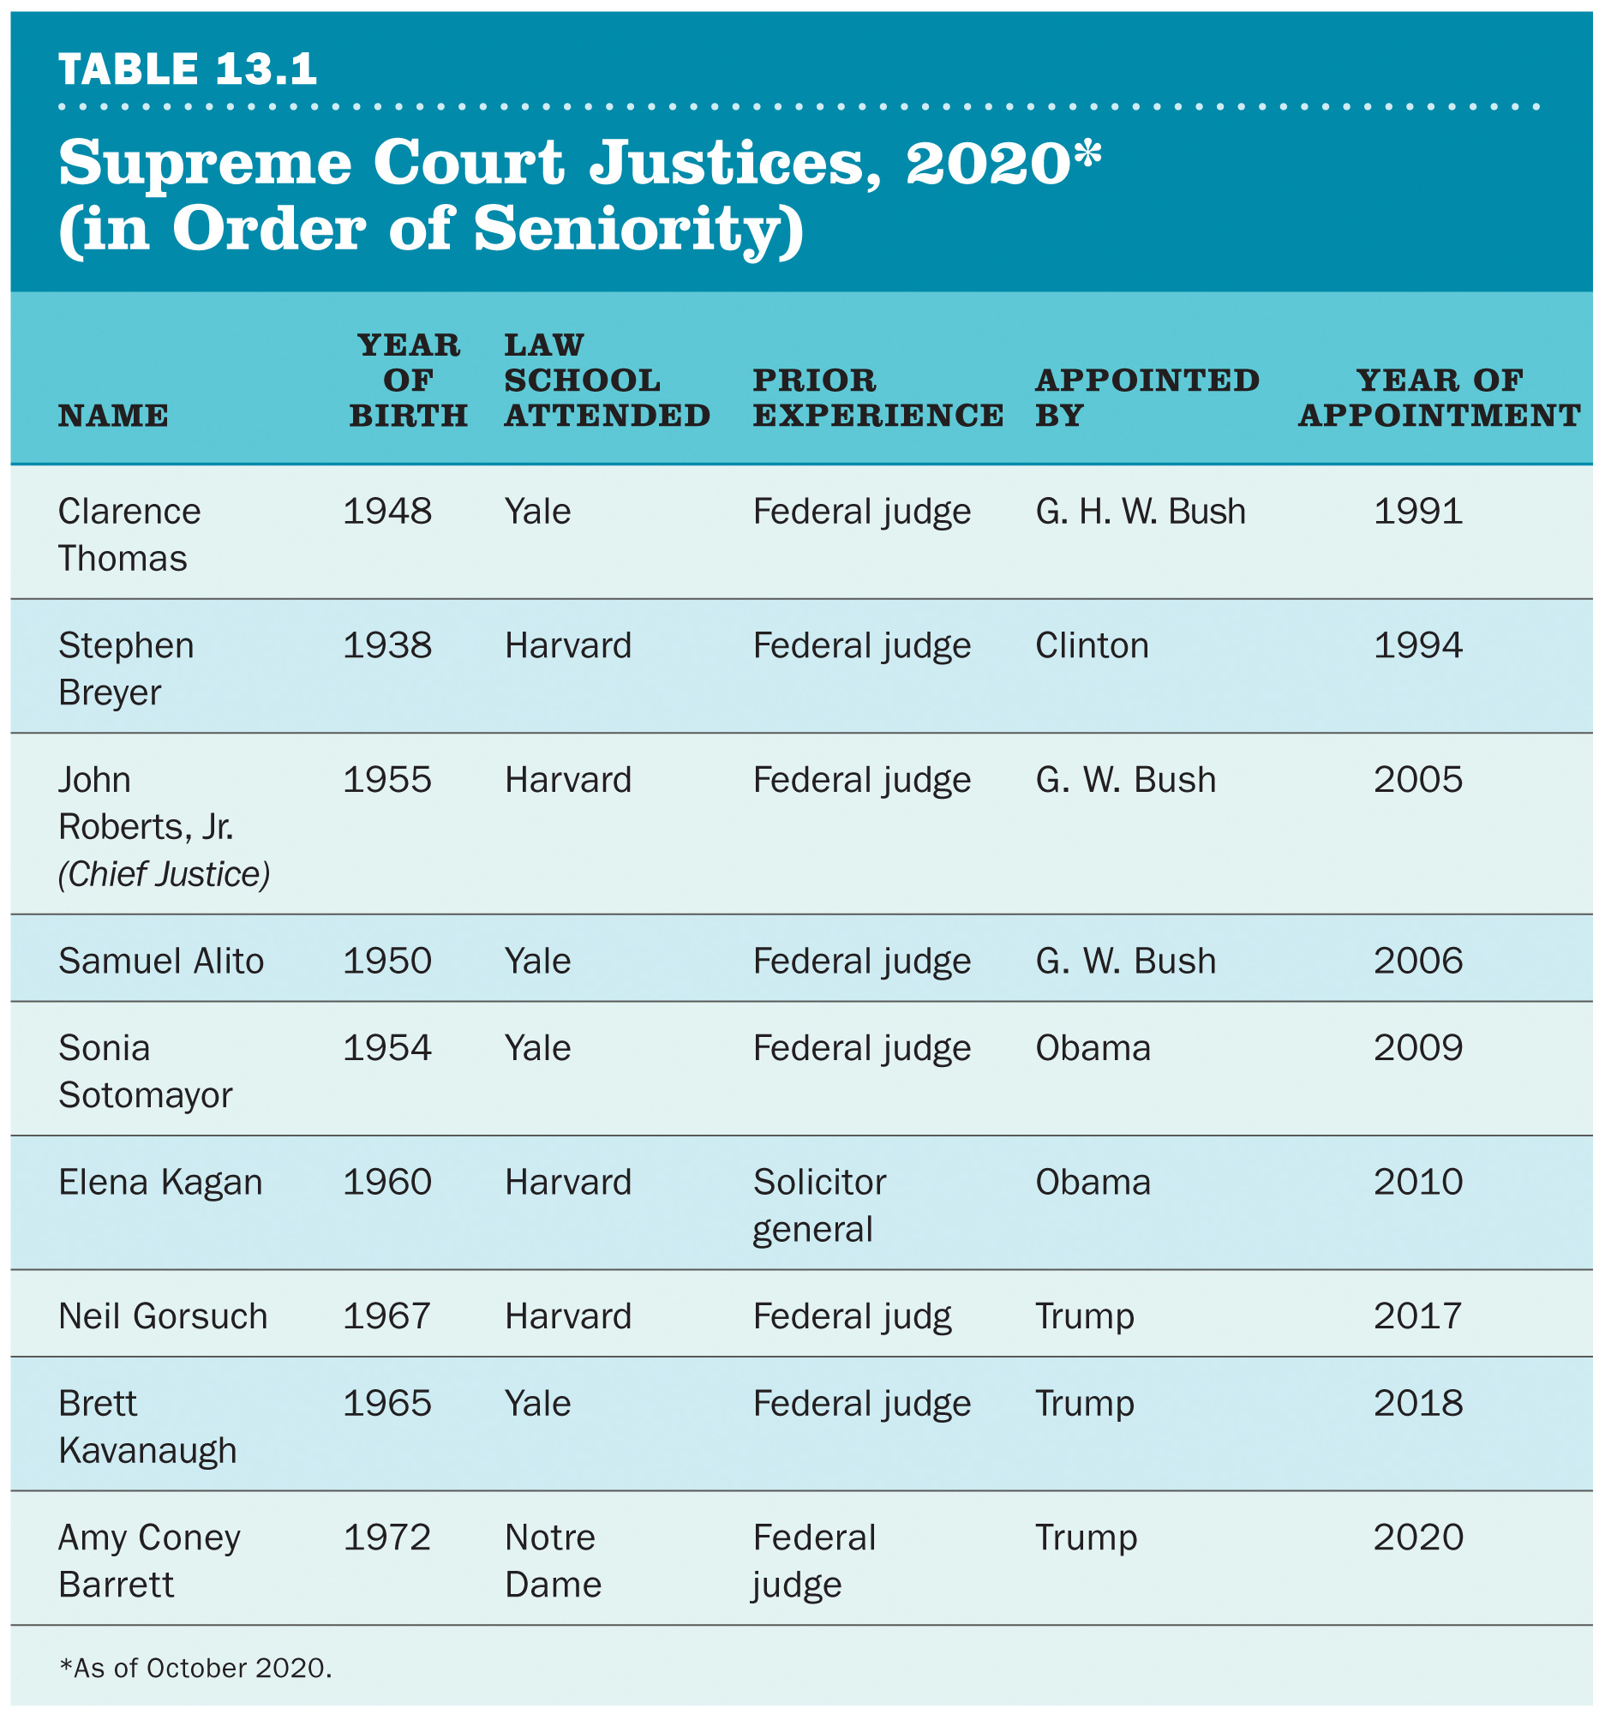
Supreme Court Justices, 2020 (in Order of Seniority)
NAME | YEAR OF BIRTH | Law School Attended | PRIOR EXPERIENCE | APPOINTED BY | YEAR OF APPOINTMENT
Clarence Thomas | 1948 | Yale | Federal judge | G. H. W. Bush | 1991
Stephen Breyer | 1938 | Harvard | Federal judge | Clinton | 1994
John Roberts, Jr. (Chief Justice) | 1955 | Harvard | Federal judge | G. W. Bush | 2005
Samuel Alito | 1950 | Yale | Federal judge | G. W. Bush | 2006
Sonia Sotomayor | 1954 | Yale | Federal judge | Obama | 2009
Elena Kagan | 1960 | Harvard | Solicitor general | Obama | 2010
Neil Gorsuch | 1967 | Harvard | Federal judge | Trump | 2017
Brett Kavanaugh | 1965 | Yale | Federal judge | Trump | 2018
Amy Coney Barrett | 1972 | Notre Dame | Federal judge | Trump | 2020
Notes:
TABLE 13.1 Supreme Court Justices, 2020* (in Order of Seniority)
*As of October 2020

Slide 21
Supreme Court Appointments
In recent years, Supreme Court nominations have involved intense partisan struggles.
In 2017, the Republicans changed the filibuster rules on Supreme Court nominees.
This secured the appointment of Neil Gorsuch and later Brett Kavanaugh and Amy Coney Barrett to the Court.

Slide 22
U.S. Supreme Court: Judicial Review
The most significant power of the Court is judicial review.
This is the power of courts to review and, if necessary, declare laws or executive actions invalid or unconstitutional.
The U.S. Constitution does not mention judicial review.
The power comes from Marbury v. Madison (1803).
In more than two centuries, the Court has declared fewer than 160 acts of Congress to be unconstitutional.
Notes:
The details of Marbury v. Madison are rather complicated; the bottom line is that the Supreme Court declared its right to judicial review.
Yet because the case demanded no actions, no other branch had any opportunity to contest it.

Slide 23
Judicial Review: States
The U.S. Supreme Court can review the constitutionality of state laws, based on the supremacy clause of the U.S. Constitution.
The supremacy clause states that laws passed by the national government and all treaties are the supreme law of land and superior to all laws adopted by any state or any subdivision.
The Court has used judicial review to strike down state laws that violated rights or privileges guaranteed by the Constitution or federal statutes.

Slide 24
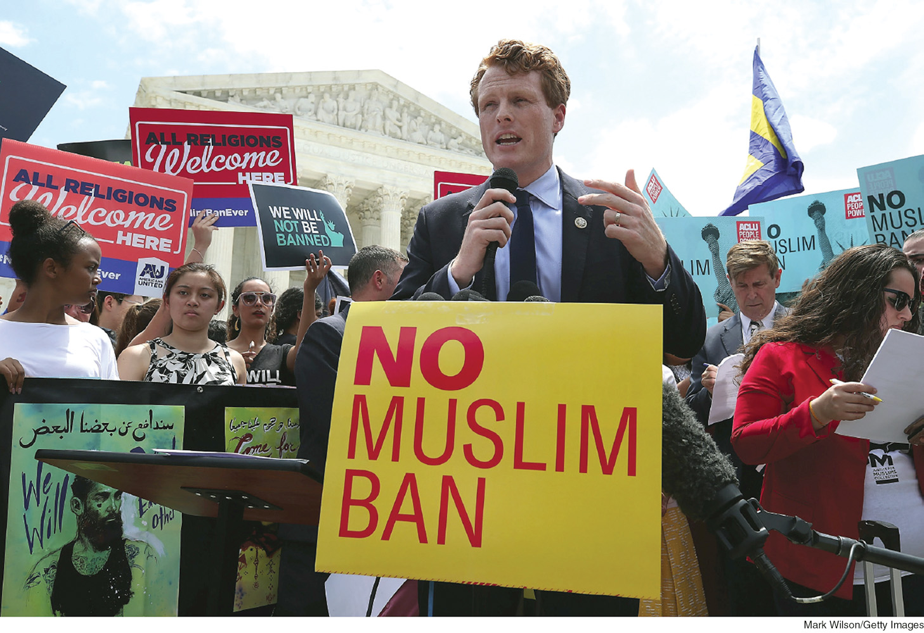
Judicial Review: The President, Part Two
Notes:
The courts may be called on to review the actions of the president. After President Trump’s “travel ban” was implemented in early 2017, many court cases challenged this policy, and eventually one case was tried before the Supreme Court. In a 5–4 decision, the Court upheld the travel ban, sparking outrage from Democratic lawmakers like Representative Joe Kennedy III (Mass.).
[Mark Wilson/Getty Images]

Slide 25
Judicial Review: Federal Agency Actions
Congress inevitably delegates power to the president and the bureaucracy to implement and interpret laws.
A number of court decisions have dealt with the scope of this delegation of power. Courts have also had to decide whether regulations adopted by federal agencies are consistent with Congress’s express or implied intent.

Slide 26
Judicial Review: The President
Federal courts have upheld presidential power in the realms of foreign policy, war and emergency powers, legislative power, and administrative authority.
Historically, the U.S. Supreme Court has been hesitant to judge presidential authority during wartime.
However, in Hamdi v. Rumsfeld (2004), the Court ruled that a captured U.S.-born Taliban soldier was entitled to a lawyer.
The Court therefore asserted that presidential actions were subject to judicial scrutiny.
The Court has also heard cases unrelated to war powers, including finding that President Obama had acted unconstitutionally by making recess appointments to the National Labor Relations Board.

Slide 27
Accessing the Supreme Court: Criteria
The Supreme Court has developed specific rules that govern which cases within its jurisdiction it will and will not hear:
The case must involve an actual dispute, not a hypothetical one.
Parties to a case must have standing: they must have a substantial stake in the outcome of the case.
The Court will not hear cases on issues that it considers to be moot.
Mootness: a criterion used to dismiss cases that no longer require a resolution.
If the issue has already been resolved, then there will be nothing to address.

Slide 28
Accessing the Supreme Court: Writs
Most cases reach the Court through a writ of certiorari: a decision of at least four of the nine Supreme Court justices to review a lower-court decision.
“Certworthy” cases include those that involve:
Conflicting decisions by two or more state courts of last resort
Conflicting decisions by two or more circuit courts
Conflicting decisions by circuit courts and state courts of last resort
Decisions by the circuit court on matters of federal law that should be settled by the Supreme Court
Circuit court decisions that are at odds with a Supreme Court decision

Slide 29
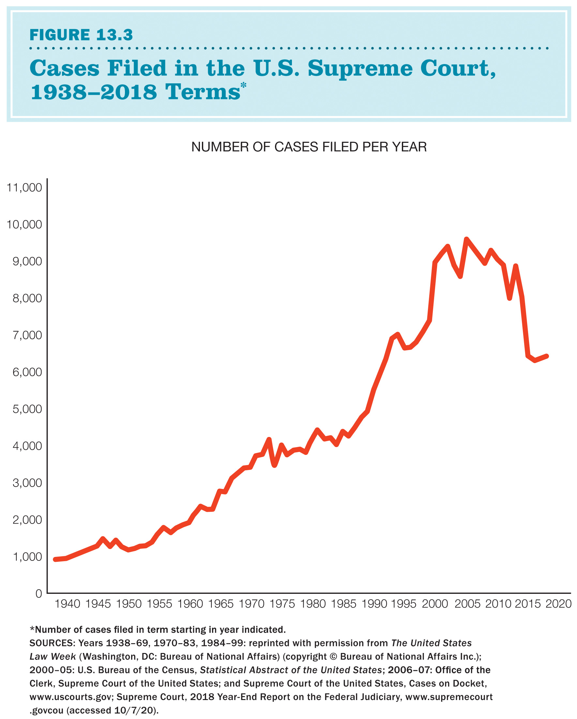
Cases Filed in the U.S. Supreme Court
Notes:
FIGURE 13.3 Cases Filed in the U.S. Supreme Court, 1938–2017 Terms*
*Number of cases filed in term starting in year indicated.
SOURCES: Years 1938–69, 1970–83, 1984–99: reprinted with permission from The United States Law Week (Washington, DC: Bureau of National Affairs) (copyright © Bureau of National Affairs Inc.); 2000–05: U.S. Bureau of the Census, Statistical Abstract of the United States; 2006–07: Office of the Clerk, Supreme Court of the United States; and Supreme Court of the United States, Cases on Docket, www.uscourts.gov; Supreme Court, 2018 Year-End Report on the Federal Judiciary, www.supremecourt.govcou (accessed 10/7/20).

Slide 30
Controlling the Flow of Cases: Solicitor General
The solicitor general—the top government lawyer in all cases before the U.S. Supreme Court in which the government is a party—has great influence over the federal courts.
Serves as the third-ranking official in the Justice Department
Screens cases before any agency of the federal government can appeal them to the Supreme Court
Can enter a case even if the federal government is not a direct litigant by writing an amicus curiae (“friend of the court”) brief

Slide 31
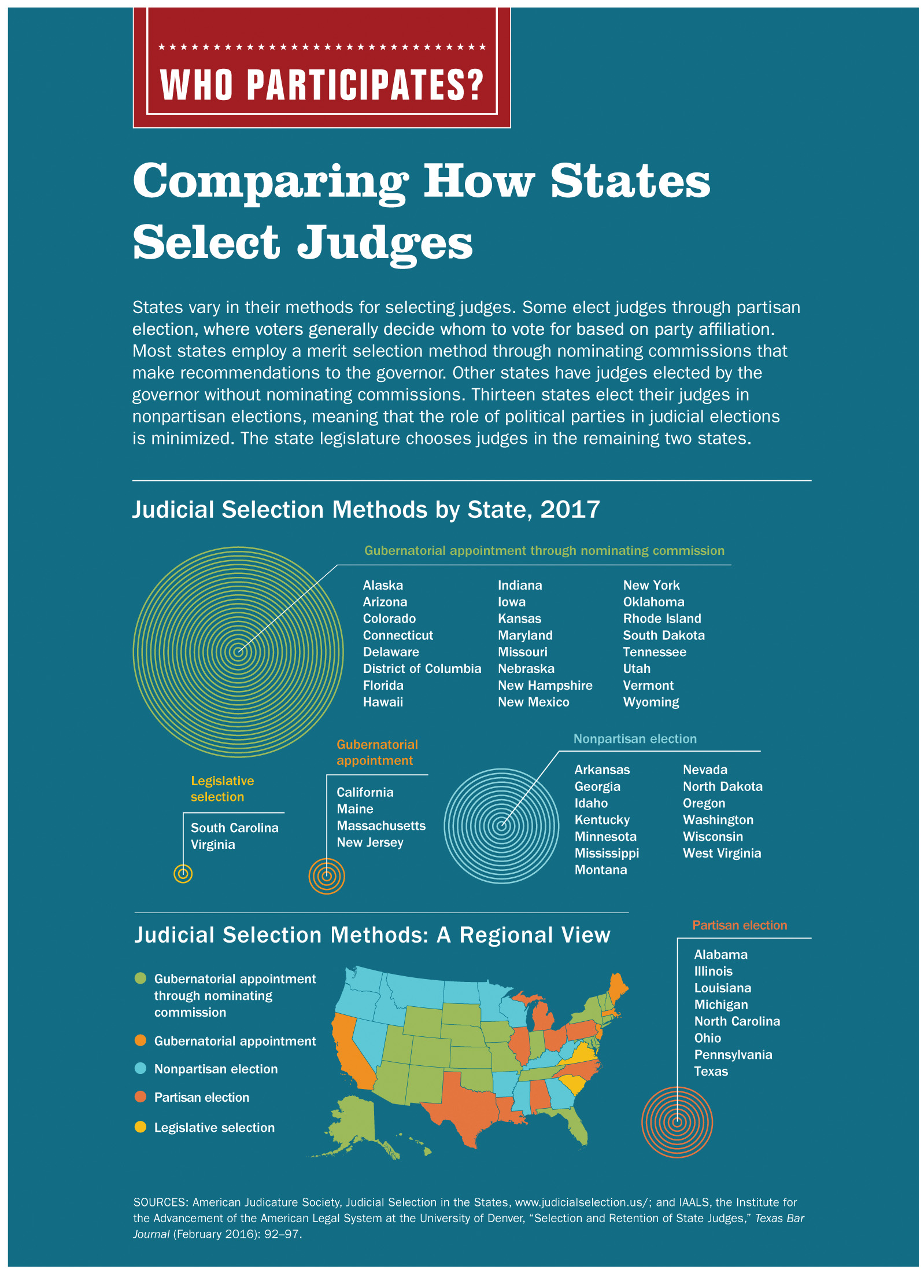
Who Participates?: Comparing How States Select Judges
Notes:
WHO PARTICIPATES? Comparing How States Select Judges
SOURCES: American Judicature Society, Judicial Selection in the States, www.judicialselection.us/; and IAALS, the Institute for the Advancement of the American Legal System at the University of Denver, “Selection and Retention of State Judges,” Texas Bar Journal (February 2016): 92–97.

Slide 32
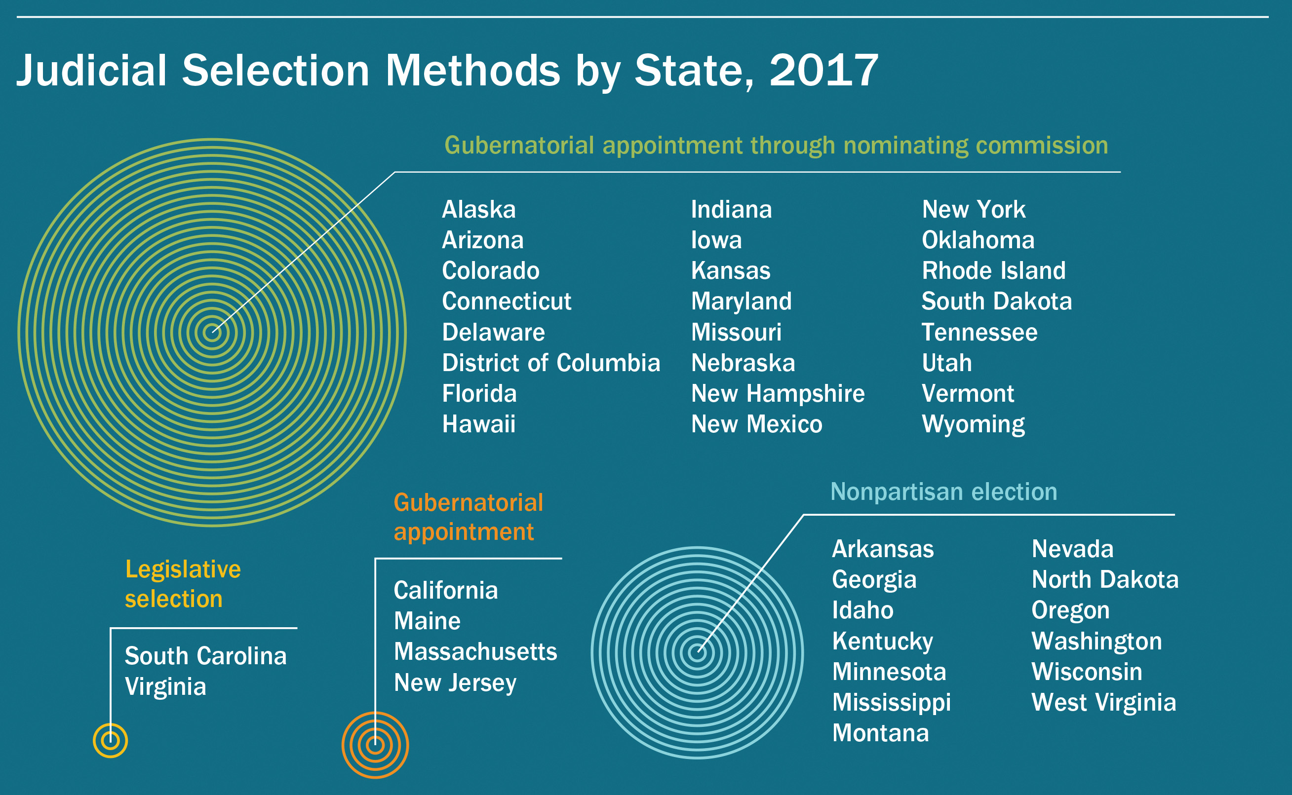
Who Participates?: Judicial Selection Methods by State
Notes:
WHO PARTICIPATES? Comparing How States Select Judges
SOURCES: American Judicature Society, Judicial Selection in the States, www.judicialselection.us/; and IAALS, the Institute for the Advancement of the American Legal System at the University of Denver, “Selection and Retention of State Judges,” Texas Bar Journal (February 2016): 92–97.

Slide 33
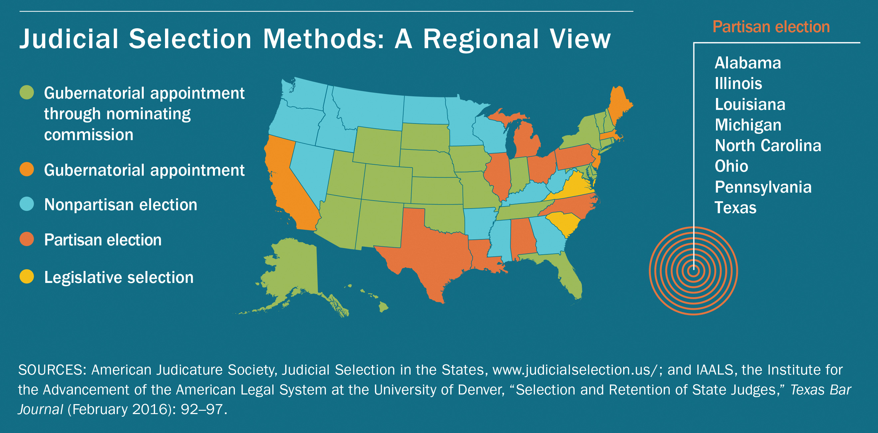
Who Participates?: Judicial Selection Methods by Region
Notes:
WHO PARTICIPATES? Comparing How States Select Judges
SOURCES: American Judicature Society, Judicial Selection in the States, www.judicialselection.us/; and IAALS, the Institute for the Advancement of the American Legal System at the University of Denver, “Selection and Retention of State Judges,” Texas Bar Journal (February 2016): 92–97.

Slide 34
Controlling the Flow of Cases: Law Clerks
Federal judges employ law clerks who research legal issues and assist with the preparation of opinions.
Each Supreme Court justice is assigned four clerks.
Law clerks help justices with advice in writing opinions and in deciding whether the Court should hear a case.

Slide 35
Lobbying for Access
Some interest groups seek to persuade justices to listen to their problems.
Lawyers representing these groups try to choose the proper client and case so that the issues in question can be both dramatically and appropriately portrayed.
When possible, they bring cases in a district with a sympathetic judge.
One effective strategy for getting cases accepted for review is to develop a ”pattern of cases.”
They bring one type of suit to more than one circuit in the hope of inconsistent treatment.

Slide 36
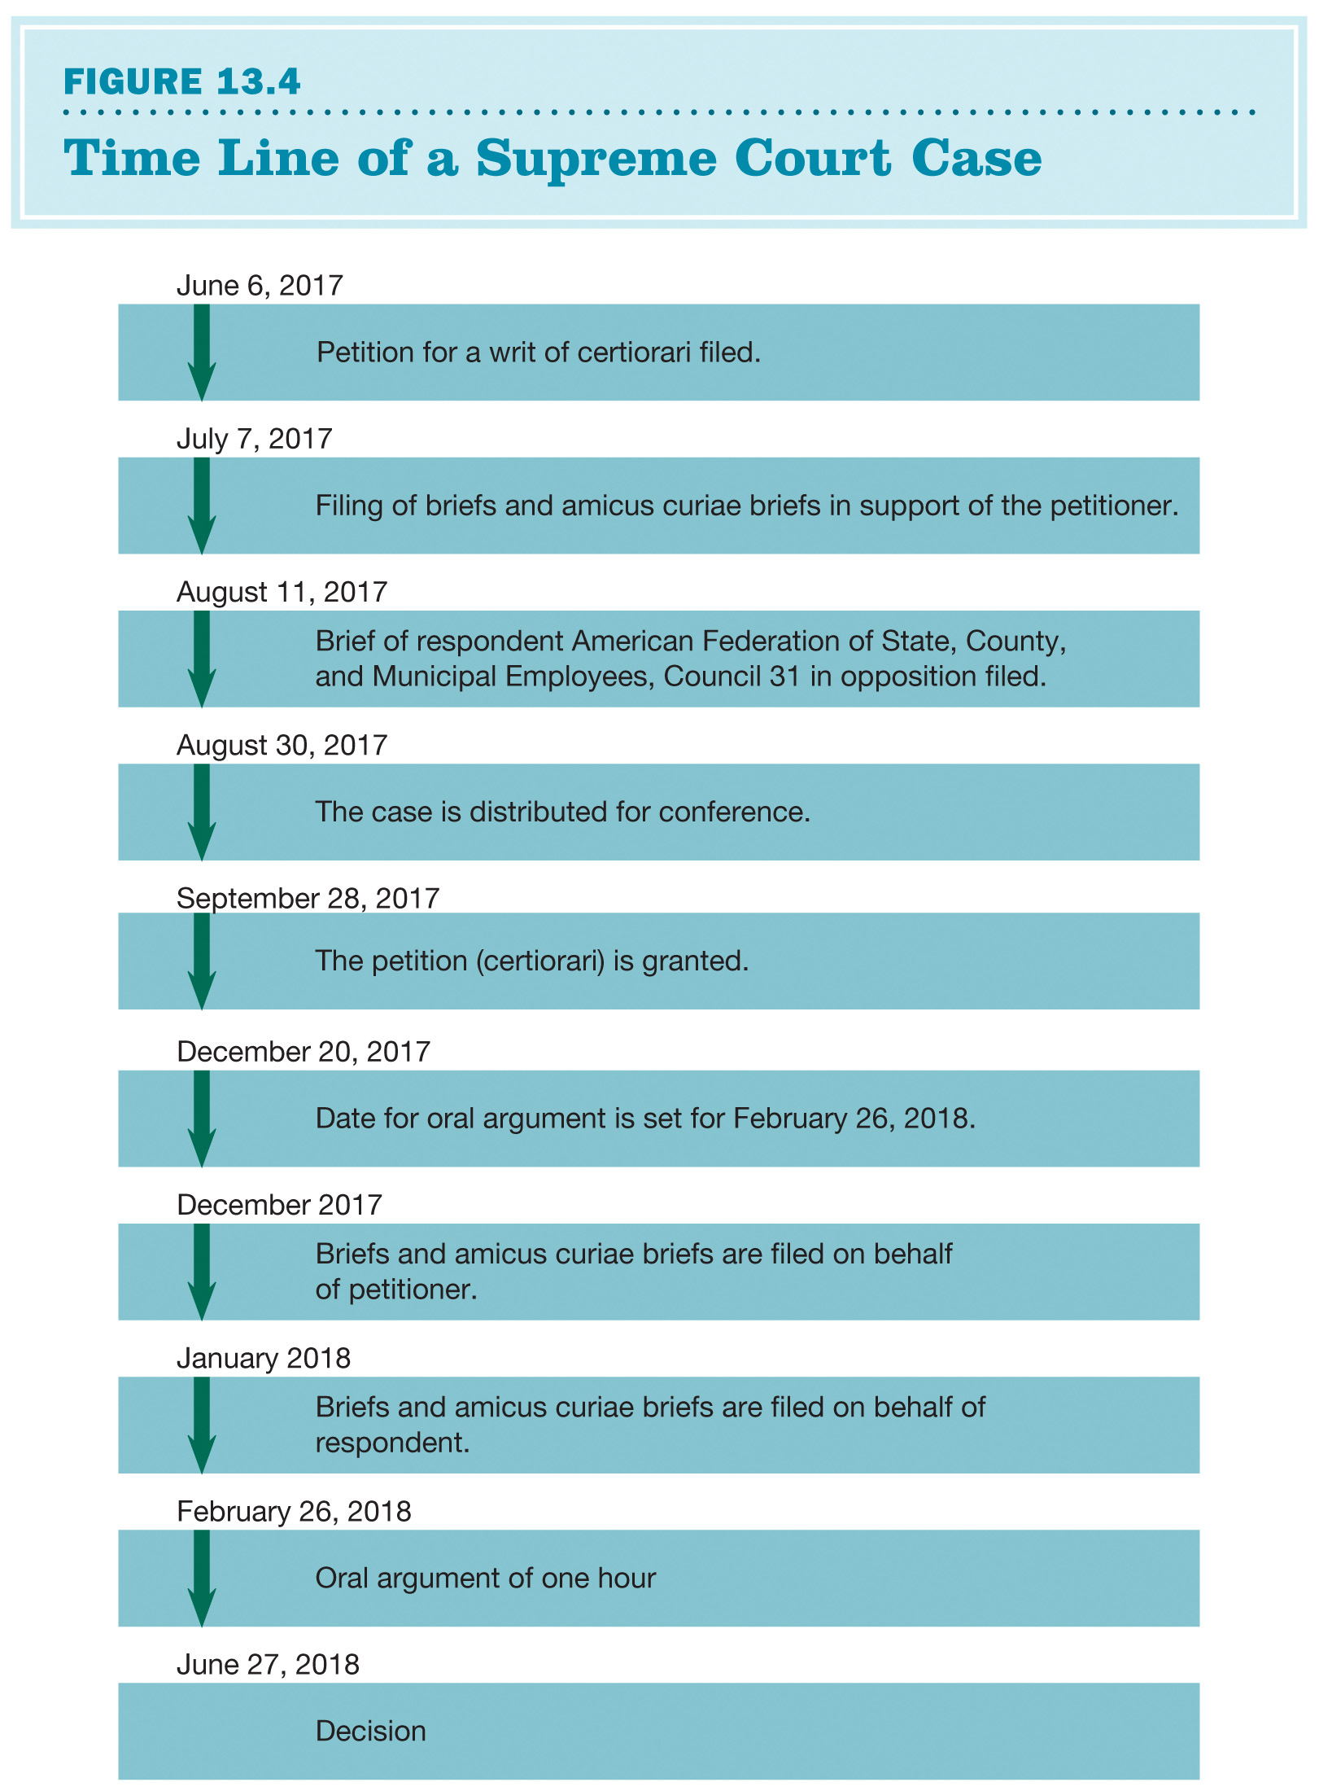
The Supreme Court’s Procedures: Time Line of a Supreme Court Case
Notes:
FIGURE 13.4 Time Line of a Supreme Court Case
This calendar of events in the case of Janus v. American Federation of State, County, and Municipal Employees illustrates the steps of the process a case goes through as it moves through the Supreme Court. The total time from petition to the Supreme Court to the decision is just over one year, although the initial case was filed years ago in a lower court.

Slide 37
The Supreme Court’s Procedures: Preparation
The Supreme Court’s decision to accept a case is the start of a lengthy and complex process.
Both sides submit briefs, as do other interested parties.
Briefs: written documents in which attorneys explain, using case precedents, why a court should find in favor of their client
Attorneys often ask sympathetic interest groups for support (via amicus curiae briefs).

Slide 38
The Supreme Court’s Procedures: Oral Argument
The next stage of a case is oral argument: attorneys for both sides appear before the Court to present their positions and answer the justices’ questions.
Each attorney has a half hour to present a case, which includes interruptions for questions.
Oral arguments can be important to the outcome of the case.

Slide 39
The Supreme Court’s Procedures: Conference
The conference follows the oral argument.
The justices meet in private and hold an initial vote.
The chief justice speaks first, and other justices follow in order of seniority.
A decision is reached on the basis of a majority vote.
If the Court is divided, a number of votes may be taken before a final decision is reached.
The justices may try to influence or change one another’s opinions.

Slide 40
The Supreme Court’s Procedures: Opinions
After a decision is reached, one justice in the majority is assigned to write the opinion: the written explanation of the Supreme Court’s decision.
A chief justice who is in the majority will assign a justice to write the majority opinion.
If the chief justice is not in the majority, then the most senior justice in the majority will assign the opinion.
Once the majority opinion has been drafted, it is circulated to the other justices.
If a judge agrees with the decision but not the reasoning, they may write a concurring opinion.

Slide 41
The Supreme Court’s Procedures: Dissent
Justices who disagree with majority may choose to publicize their disagreement in a dissenting opinion.
may be used to express irritation with the outcome
may be done to signal to the defeated side that their position did have some support
may be done to persuade a swing justice to join their side on the next round of cases on a similar topic
Dissents act like an appeal to keep bringing cases through the Court; they influence future arguments.

Slide 42
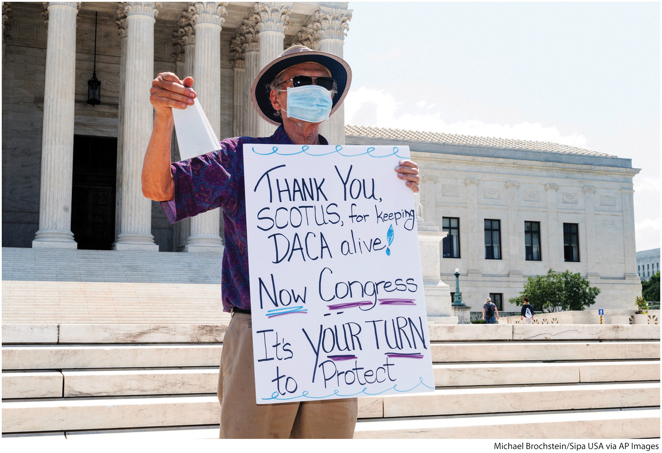
The Swing Voter on the Court
Notes:
Since the retirement of Justice Anthony Kennedy, Chief Justice John Roberts has sometimes served as a swing vote on the Court to protect the precedents set by past decisions. In 2020, he ruled with the liberal justices to reject the Trump administration's suit against DACA, a program that protects young undocumented immigrants from deportation.
[Michael Brochstein/Sipa USA via AP Images]

Slide 43
Explaining Supreme Court Decisions
The Supreme Court decides what laws mean and the importance of precedent.
Institutional interests
The justices are aware of the Court’s place in history; they care about protecting the Court’s reputation.
Justices may differ in their judicial philosophy.
Judicial restraint: judicial philosophy whose adherents refuse to go beyond the clear words of Constitution in interpreting the document’s meaning.
Judicial activism: judicial philosophy that posits that the Court should go beyond the words of the Constitution or a statute to consider the broader societal implications of its decisions

Slide 44
Traditional Limitations on the Federal Courts, Part 1
One of the most important transformations in American politics in the last century has been the growth in the role and power of the federal courts, and especially the Supreme Court. This growth is despite five traditional limitations on the power of the courts:
Courts must wait until a case is brought to them; they are “passive” players in the system.
Courts were traditionally limited in the kind of remedies they could provide those who won cases.

Slide 45
Traditional Limitations on the Federal Courts, Part 2
Courts lacked enforcement powers and had to rely on the executive branch or state agencies for enforcement.
Judges are appointed by the president and the Senate and thus somewhat reflect their agendas and goals.
Congress can change both the size and jurisdiction of the Supreme Court and other federal courts.

Slide 46
Public Opinion Poll: Q1
Do you think federal judges should be appointed for life terms, appointed for limited terms, or elected?
Federal judges should be appointed for life.
Federal judges should have limited appointment terms.
Federal judges should be elected.
Notes:
46

Slide 47
Public Opinion Poll: Q2
Do you believe the decisions of the federal courts are primarily driven by legal doctrine or individual judges’ political ideology?
legal doctrine
political ideology
Notes:
47

Slide 48
Public Opinion Poll: Q3
Do you believe members of the U.S. Senate should have the ability to block judicial nominations based solely on the nominee’s political ideology and party?
yes
no
Notes:
48

Slide 49
Public Opinion Poll: Q4
Do you believe the U.S. Supreme Court should televise or stream their proceedings?
yes
no
Notes:
49

Slide 50
Public Opinion Poll: Q5
Compared to the presidency and the Congress, do you think the Court has too little, too much, or the right amount of influence on American policy and law?
too little influence
too much influence
about right amount
Notes:
50

Slide 51
Additional Information
Following this slide, you will find additional images, figures, and tables from the textbook.
Notes:
51

Slide 52
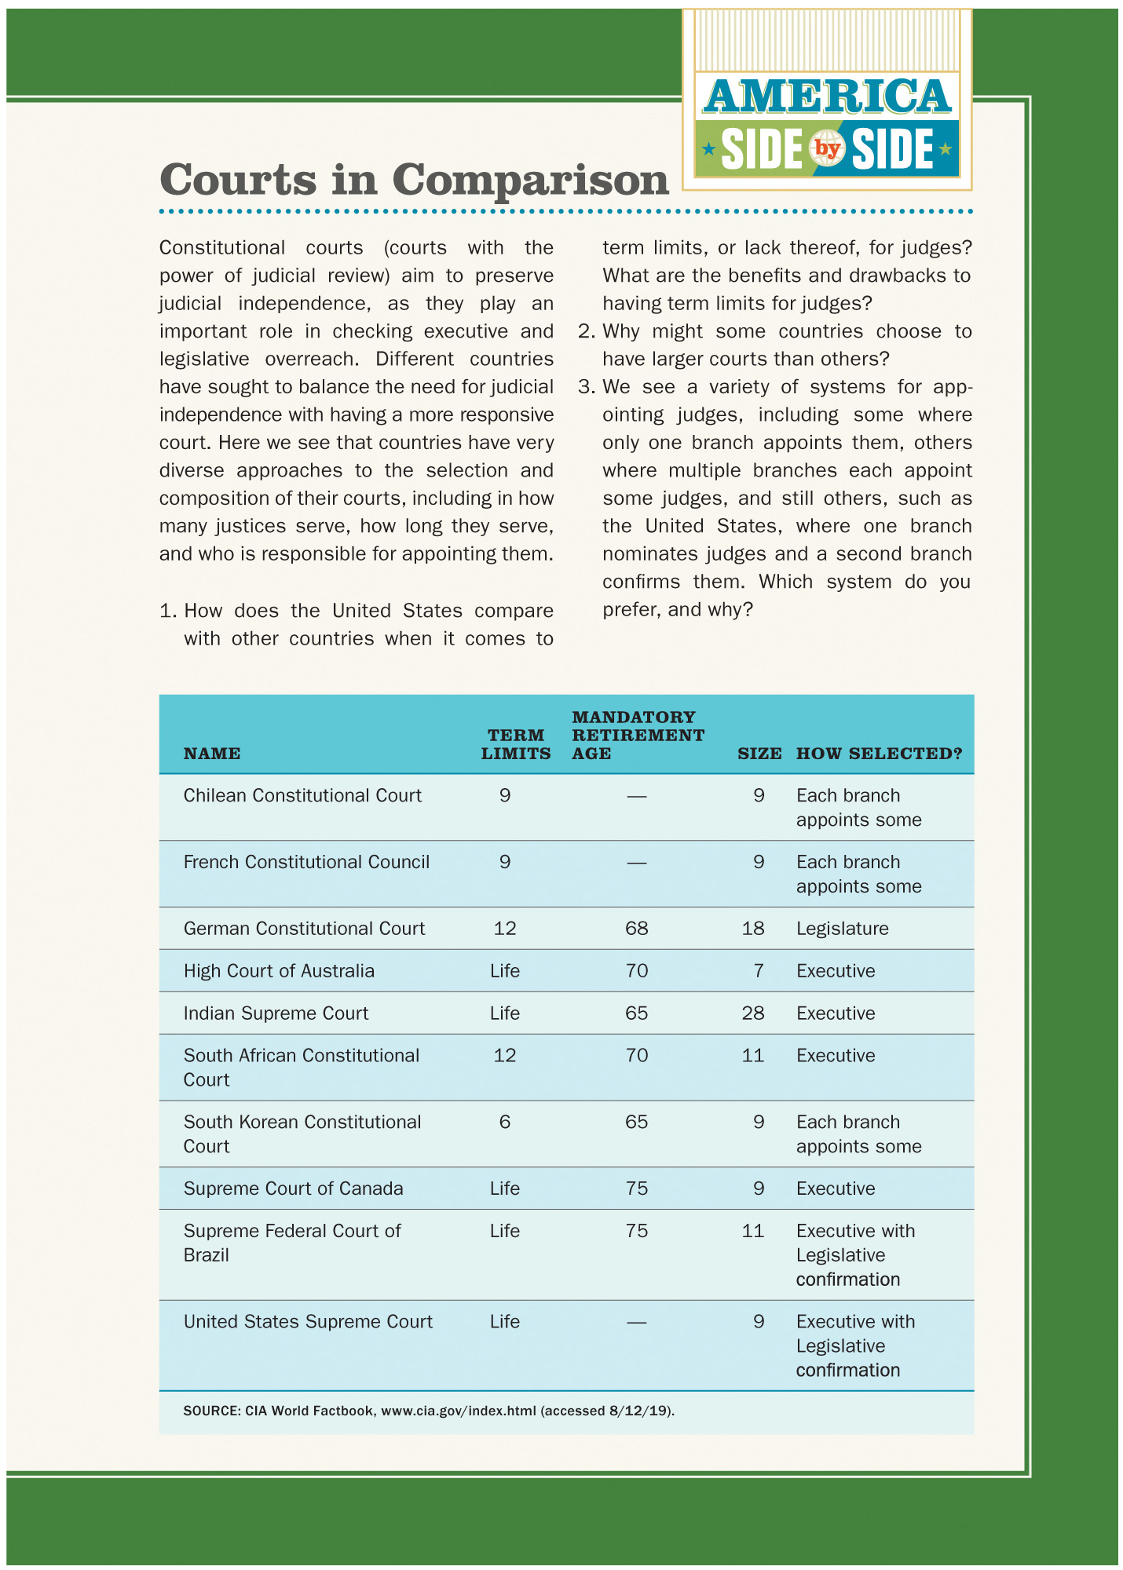
America Side by Side: Courts in Comparison
Name | Term Limits | Mandatory retirement age | Size | How selected?
Chilean Constitutional Court | 9 | Nil | 9 | Each branch appoints some
French Constitutional Council | 9 | Nil | 9 | Each branch appoints some
German Constitutional Court | 12 | 68 | 18 | Legislature
High Court of Australia | Life | 70 | 7 | Executive
Indian Supreme Court | Life | 65 | 28 | Executive
South African Constitutional Court | 12 | 70 | 11 | Executive
South Korean Constitutional Court | 6 | 65 | 9 | Each branch appoints some
Supreme Court of Canada | Life | 75 | 9 | Executive
Supreme Federal Court of Brazil | Life | 75 | 11 | Executive with Legislative confirmation
United States Supreme Court | Life | Nil | 9 | Executive with Legislative confirmation
Notes:
SOURCE: CIA World Factbook, www.cia.gov/index.html (accessed 8/12/19).

